Slide 1

UI Design and Implementation
GROUP 14
TASK 4
NETWORK QOE FEEDBACK APP
TUESDAY 03 JUNE 2025

Slide 2

4
Brand Overview
App Name: Vital Sign
Purpose: User-generated, real-time QoE feedback
Unique Value: Empowers users to report and improve network service quality

Slide 3



Design Details
Trait Evidence in UI
Professional ------- Dark color palette
Trustworthy ------- Clear analytics, labeled icons, verified location information
User-centric ------- Emoji feedback, Direct rating system
Calm ------- Non-overwhelming animations, clean text heirachy
Typography
Font: Poppins, Regular & Bold
Titles: Bold, uppercase
Body: Clean, small-size readable
Justification: Clean, modern, accessible look
Design Tool : Figma
FIRST PROBLEM
SECOND PROBLEM

Slide 4
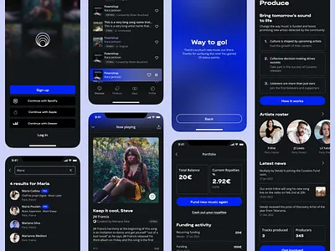
13
Key UI Screens

Slide 5
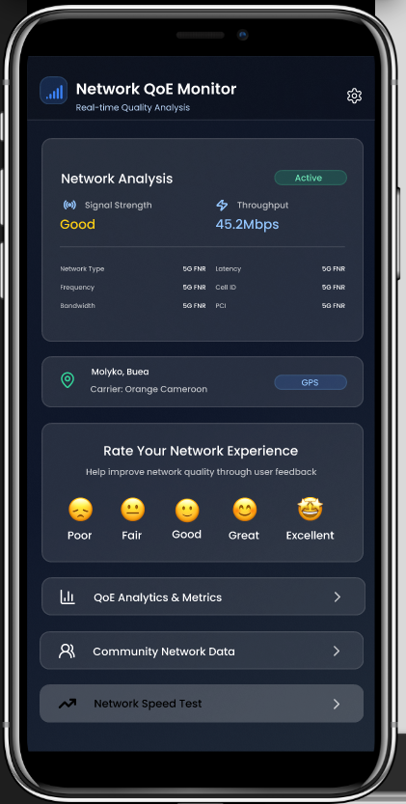
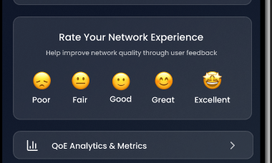
6
Real-time metrics, user entry point
Primary Dashboard Showing
Real-time network metrics (signal strength, Throughput...)
User Feedback Entry Point (User-friendly emoji rating)

Slide 6
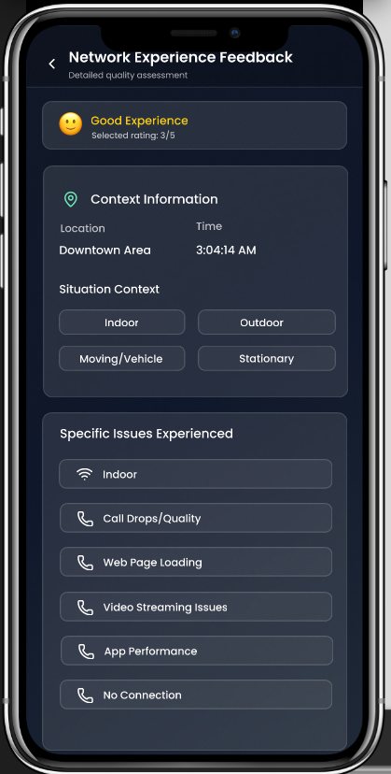
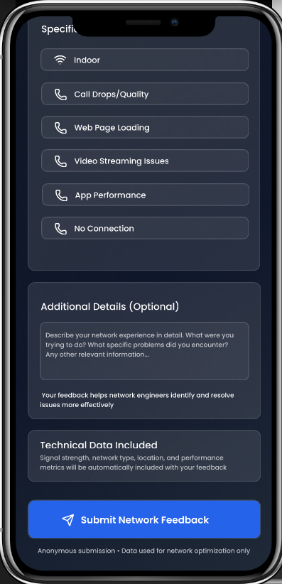
6
User Feedbacks
Easy User feedback collection showing:
Regular network challenges
Optional network experience feedback collection.

Slide 7
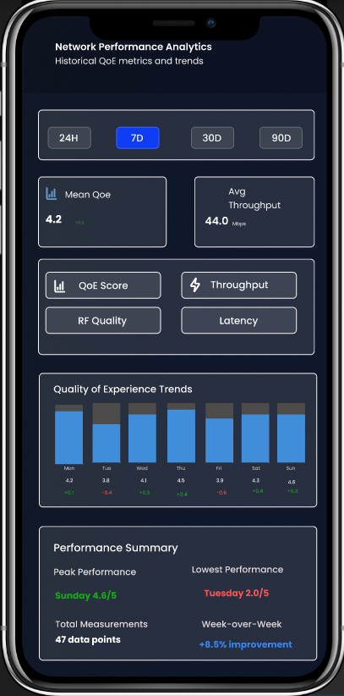
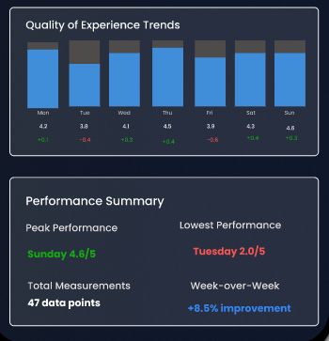
Network Analytics
Network Quality of Experience analysis over a selected period of time
Network performance summary of peak performance and lowest performance can be analyzed over a given duration

Slide 8
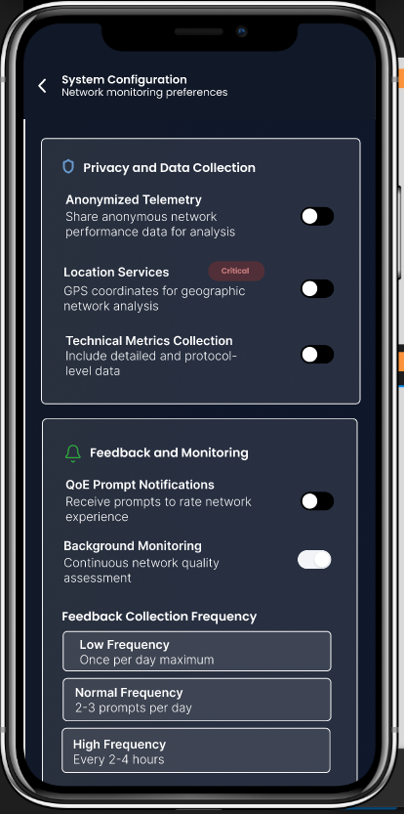
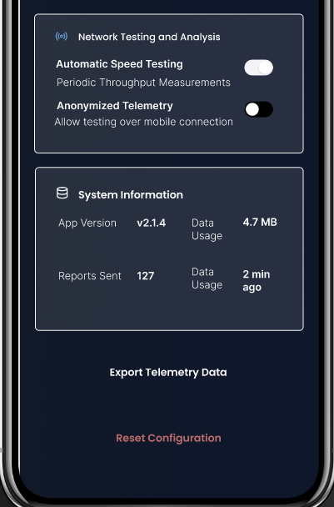
6
System Configuration
User Permission Management Interface for:
Location Service enablement
Automatic network speed testing enablement
Feedback Notification service activation

Slide 9
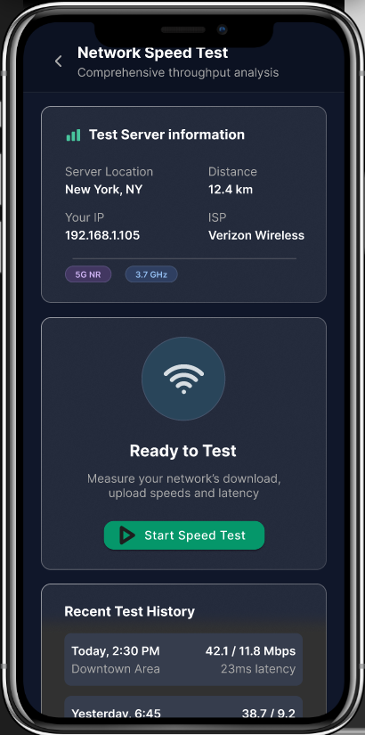
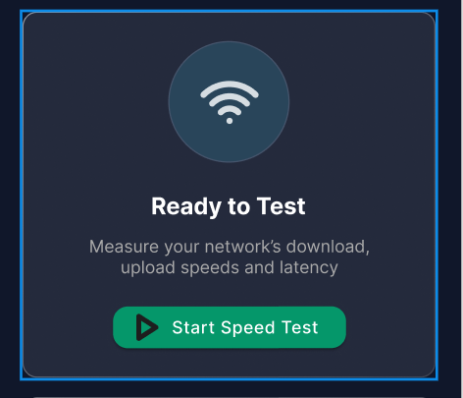
6
Network Speed Test
Speed Test feature to measure network speed, latency,... at a particular time
Displays previous test histories for further network analysis.

Slide 10




Tech Stack and Implementation
12
Dev Environment
Back-end
App UI Development

Slide 11
13
Conclusion
Haven established detailed the design of the network QoE feedback application, and given the above mentioned implementation tools, the system can be seamlessly implementation.

Slide 12

Thank
You!
GROUP 14
QOE NETWORK FEEDBACK APP

